Slide 1

Semantic Tableaux Method
Exercise 6.6 - Șipoș Lucas George

Slide 2

Exercise 6
Using the semantic tableaux method check whether the following logical consequences hold.
$$(∃x)(∀y)(Q(x,y)→P(x,y)),(∀z)Q(z,z)⊨(∃x)P(x,x)$$

Slide 3






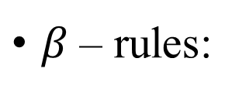

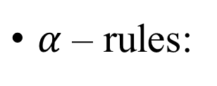











Theoretical Support
$α$ – rules:
$$A∧B$$
$$¬(A∨B)≡¬A∧¬B$$
$$¬(A→B)≡A∧¬B$$
$$A$$
$$¬A$$
$$A$$
$$B$$
$$¬B$$
$$¬B$$
$β$ – rules:
$$A∨B$$
$$¬(A∧B)≡¬A∨¬B$$
$$A→B≡¬A∨B$$
$$A$$
$$B$$
$$¬A$$
$$¬B$$
$$¬A$$
$$B$$

Slide 4











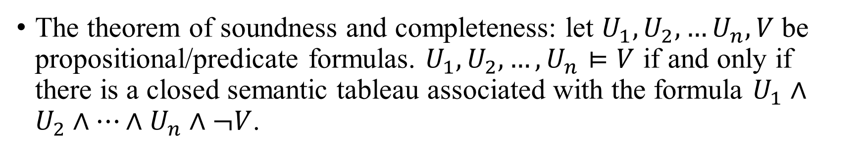



$γ$ – rules:
$δ$ – rules:
$$\left(∀x\right)A(x)$$
$$¬\left(∃x\right)A(x)≡\left(∀x\right)¬A(x)$$
$$\left(∃x\right)A(x)$$
$$¬ \left(∀x\right)A(x)≡\left(∃x\right)¬A(x)$$
$$A\left(c_{1}\right)$$
$$¬A\left(c_{1}\right)$$
$$A\left(c\right)$$
$$¬A\left(c\right)$$
$$A\left(c_{2}\right)$$
$$¬A\left(c_{2}\right)$$
$$⋮$$
$$⋮$$
$$A\left(c_{n}\right)$$
$$¬A\left(c_{n}\right)$$
$$\left(∀x\right)A(x)$$
$$¬\left(∃x\right)A(x)$$
The theorem of soundness and completeness: let $U_{1},U_{2},…U_{n},V$ be propositional/predicate formulas. $U_{1},U_{2},…,U_{n}⊨V$ if and only if there is a closed semantic tableau associated with the formula $U_{1}∧U_{2}∧…∧U_{n}∧¬V$.

Slide 5
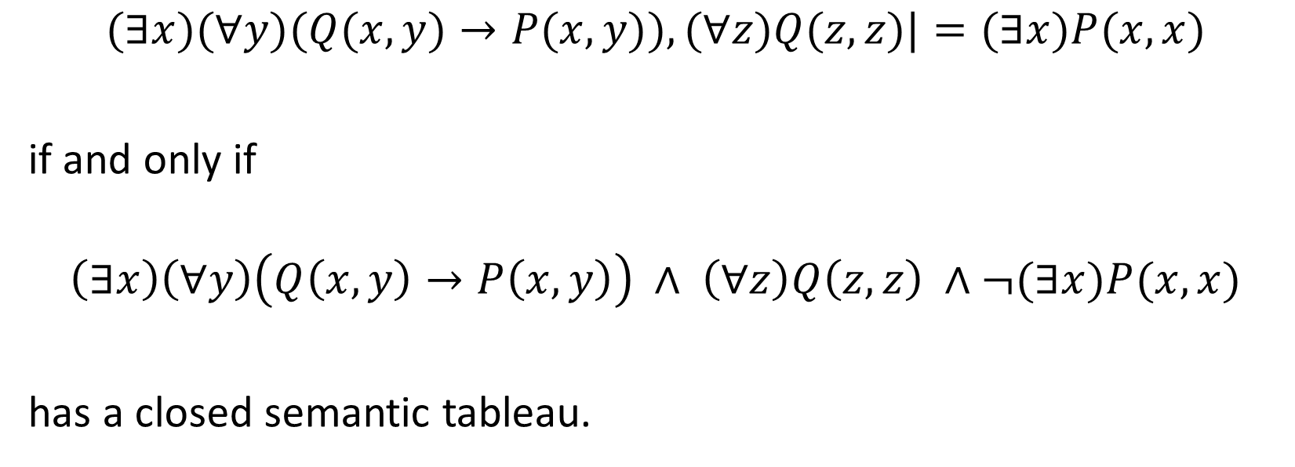
Step I. Apply the soundness & completeness theorem
$$(∃x)(∀y)(Q(x,y)→P(x,y)),(∀z)Q(z,z)|=(∃x)P(x,x)$$
if and only if
$$\left(∃x\right)\left(∀y\right)\left(Q\left(x,y\right)→P\left(x,y\right)\right) ∧ \left(∀z\right)Q\left(z,z\right) ∧¬(∃x)P(x,x)$$
has a closed semantic tableau.

Slide 6
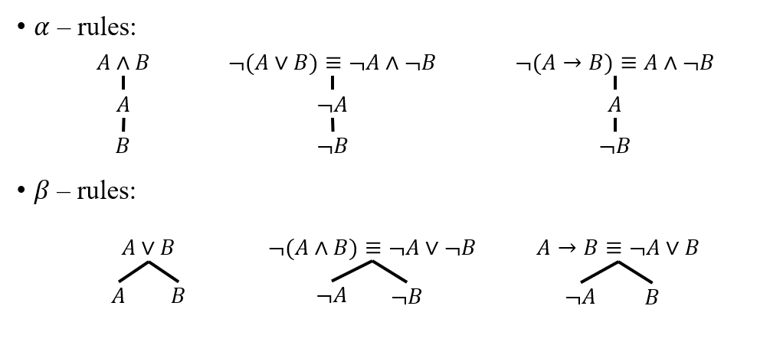
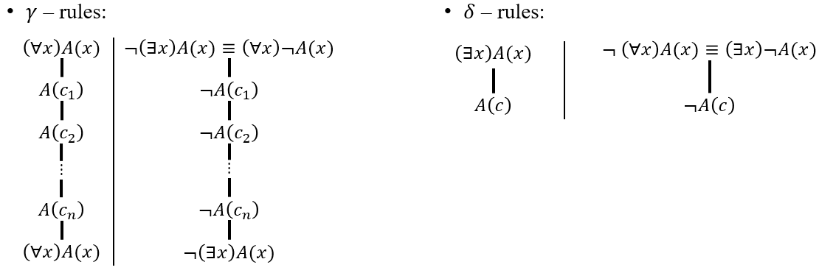









Step II. Building the semantic tableau
$\left(∃x\right)\left(∀y\right)\left(Q\left(x,y\right)→P\left(x,y\right)\right) ∧ \left(∀z\right)Q\left(z,z\right) ∧¬(∃x)P(x,x)$ (1)
$α$ – rule for (1)
$\left(∃x\right)\left(∀y\right)\left(Q\left(x,y\right)→P\left(x,y\right)\right)$ (2)
$\left(∀z\right)Q\left(z,z\right)$ (3)
$¬(∃x)P(x,x)≡(∀x)¬P(x,x)$ (4)
$δ$ – rule for (2), c is a new constant
$\left(∀y\right)\left(Q\left(c,y\right)→P\left(c,y\right)\right)$ (5)
$γ$ – rule for (5), c is used for instantiation
$Q\left(c,c\right)→P\left(c,c\right)$ (6)
$\left(∀y\right)\left(Q\left(c,y\right)→P\left(c,y\right)\right)$ (7), copy of (5)
$γ$ – rule for (3), c is used for instantiation
$Q\left(c,c\right)$ (8)
$\left(∀z\right)Q\left(z,z\right)$ (9), copy of (3)
$γ$ – rule for (4), c is used for instantiation
$¬P\left(c,c\right)$ (10)
$¬(∃x)P(x,x)$ (11), copy of (4)
$β$ – rule for (6)
$$¬Q\left(c,c\right)$$
$$P\left(c,c\right)$$
$$⨂$$
$$⨂$$

Slide 7
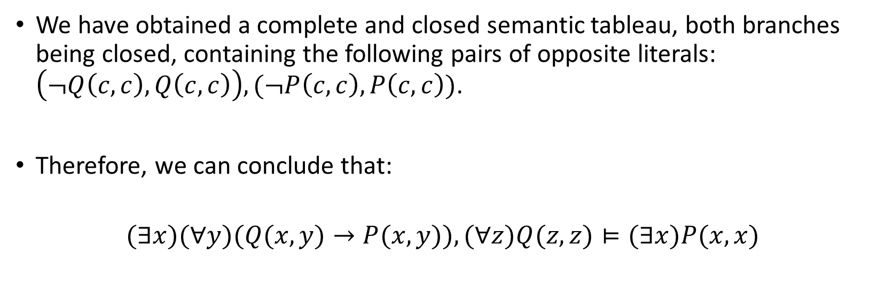
Step III. Drawing the conclusions
We have obtained a complete and closed semantic tableau, both branches being closed, containing the following pairs of opposite literals: $\left(¬Q\left(c,c\right), Q\left(c,c\right)\right), (¬P\left(c,c\right), P\left(c,c\right))$.
Therefore, we can conclude that:
$$(∃x)(∀y)(Q(x,y)→P(x,y)),(∀z)Q(z,z)⊨(∃x)P(x,x)$$

